Slide 1


Fraudulent Transaction Detection in Financial Systems
Machine Learning Project Proposal
Team Members:
Vinay Kumar Reddy Punuru
Pavan Kumar Sunkara
Veda Prakash Chiliveru
Course: DSCI:6003-03 Machine Learning Project

Slide 2



TEAM
Vinay Kumar Reddy Punuru
Veda Prakash Chiliveru
Pavan Kumar Sunkara

Slide 3
Project Goal
Objective:
Develop ML classification models to identify fraudulent transactions in financial systems.
Focus Areas:
Key factors distinguishing fraudulent vs. legitimate transactions.
Real-time fraud prediction and prevention.

Slide 4
Dataset Overview
Source:
Kaggle (Credit Card Fraud Detection Dataset)
Features:
Transaction ID, amount, merchant details, location, timestamp.
User demographics, account history, transaction type (online/in-person).
Fraud classification.

Slide 5
Methodology
Steps:
Exploratory Data Analysis (EDA): Clean and analyze the data.
Dimensionality Reduction: Use PCA to identify key features.
Machine Learning: Train models (Random Forest, XGBoost, SVM, Neural Networks).
Evaluation: Measure accuracy, precision, recall, and F1-score.

Slide 6
Exploratory Data Analysis (EDA)
Tasks:
Cleaning the dataset.
Identifying patterns and anomalies.
Visualizing feature importance and correlation.

Slide 7
Dimensionality Reduction
Techniques:
Principal Component Analysis (PCA): Highlight crucial variables.
Factor Analysis: Detect hidden relationships between features.

Slide 8
Machine Learning Models
Models Implemented:
Random Forest: Robust for high-dimensional datasets.
XGBoost: Handles complex patterns efficiently.
Support Vector Machines (SVM): Handles non-linear relationships.
Neural Networks: Detect intricate patterns in large datasets.

Slide 9
Evaluation Metrics
Metrics:
Accuracy: Overall correctness.
Precision: Correct fraud identifications out of predicted frauds.
Recall: Correctly identified frauds out of actual fraud cases.
F1-score: Balance between precision and recall.
Goal: Minimize false positives and negatives.

Slide 10
Results and Insights
Findings from EDA and Models:
Key fraud indicators.
Model performance on validation data.
Improvements achieved by feature selection.

Slide 11
Contribution
Impact:
Strengthens fraud detection mechanisms.
Reduces financial losses and enhances security.
Boosts consumer trust in financial institutions.

Slide 12
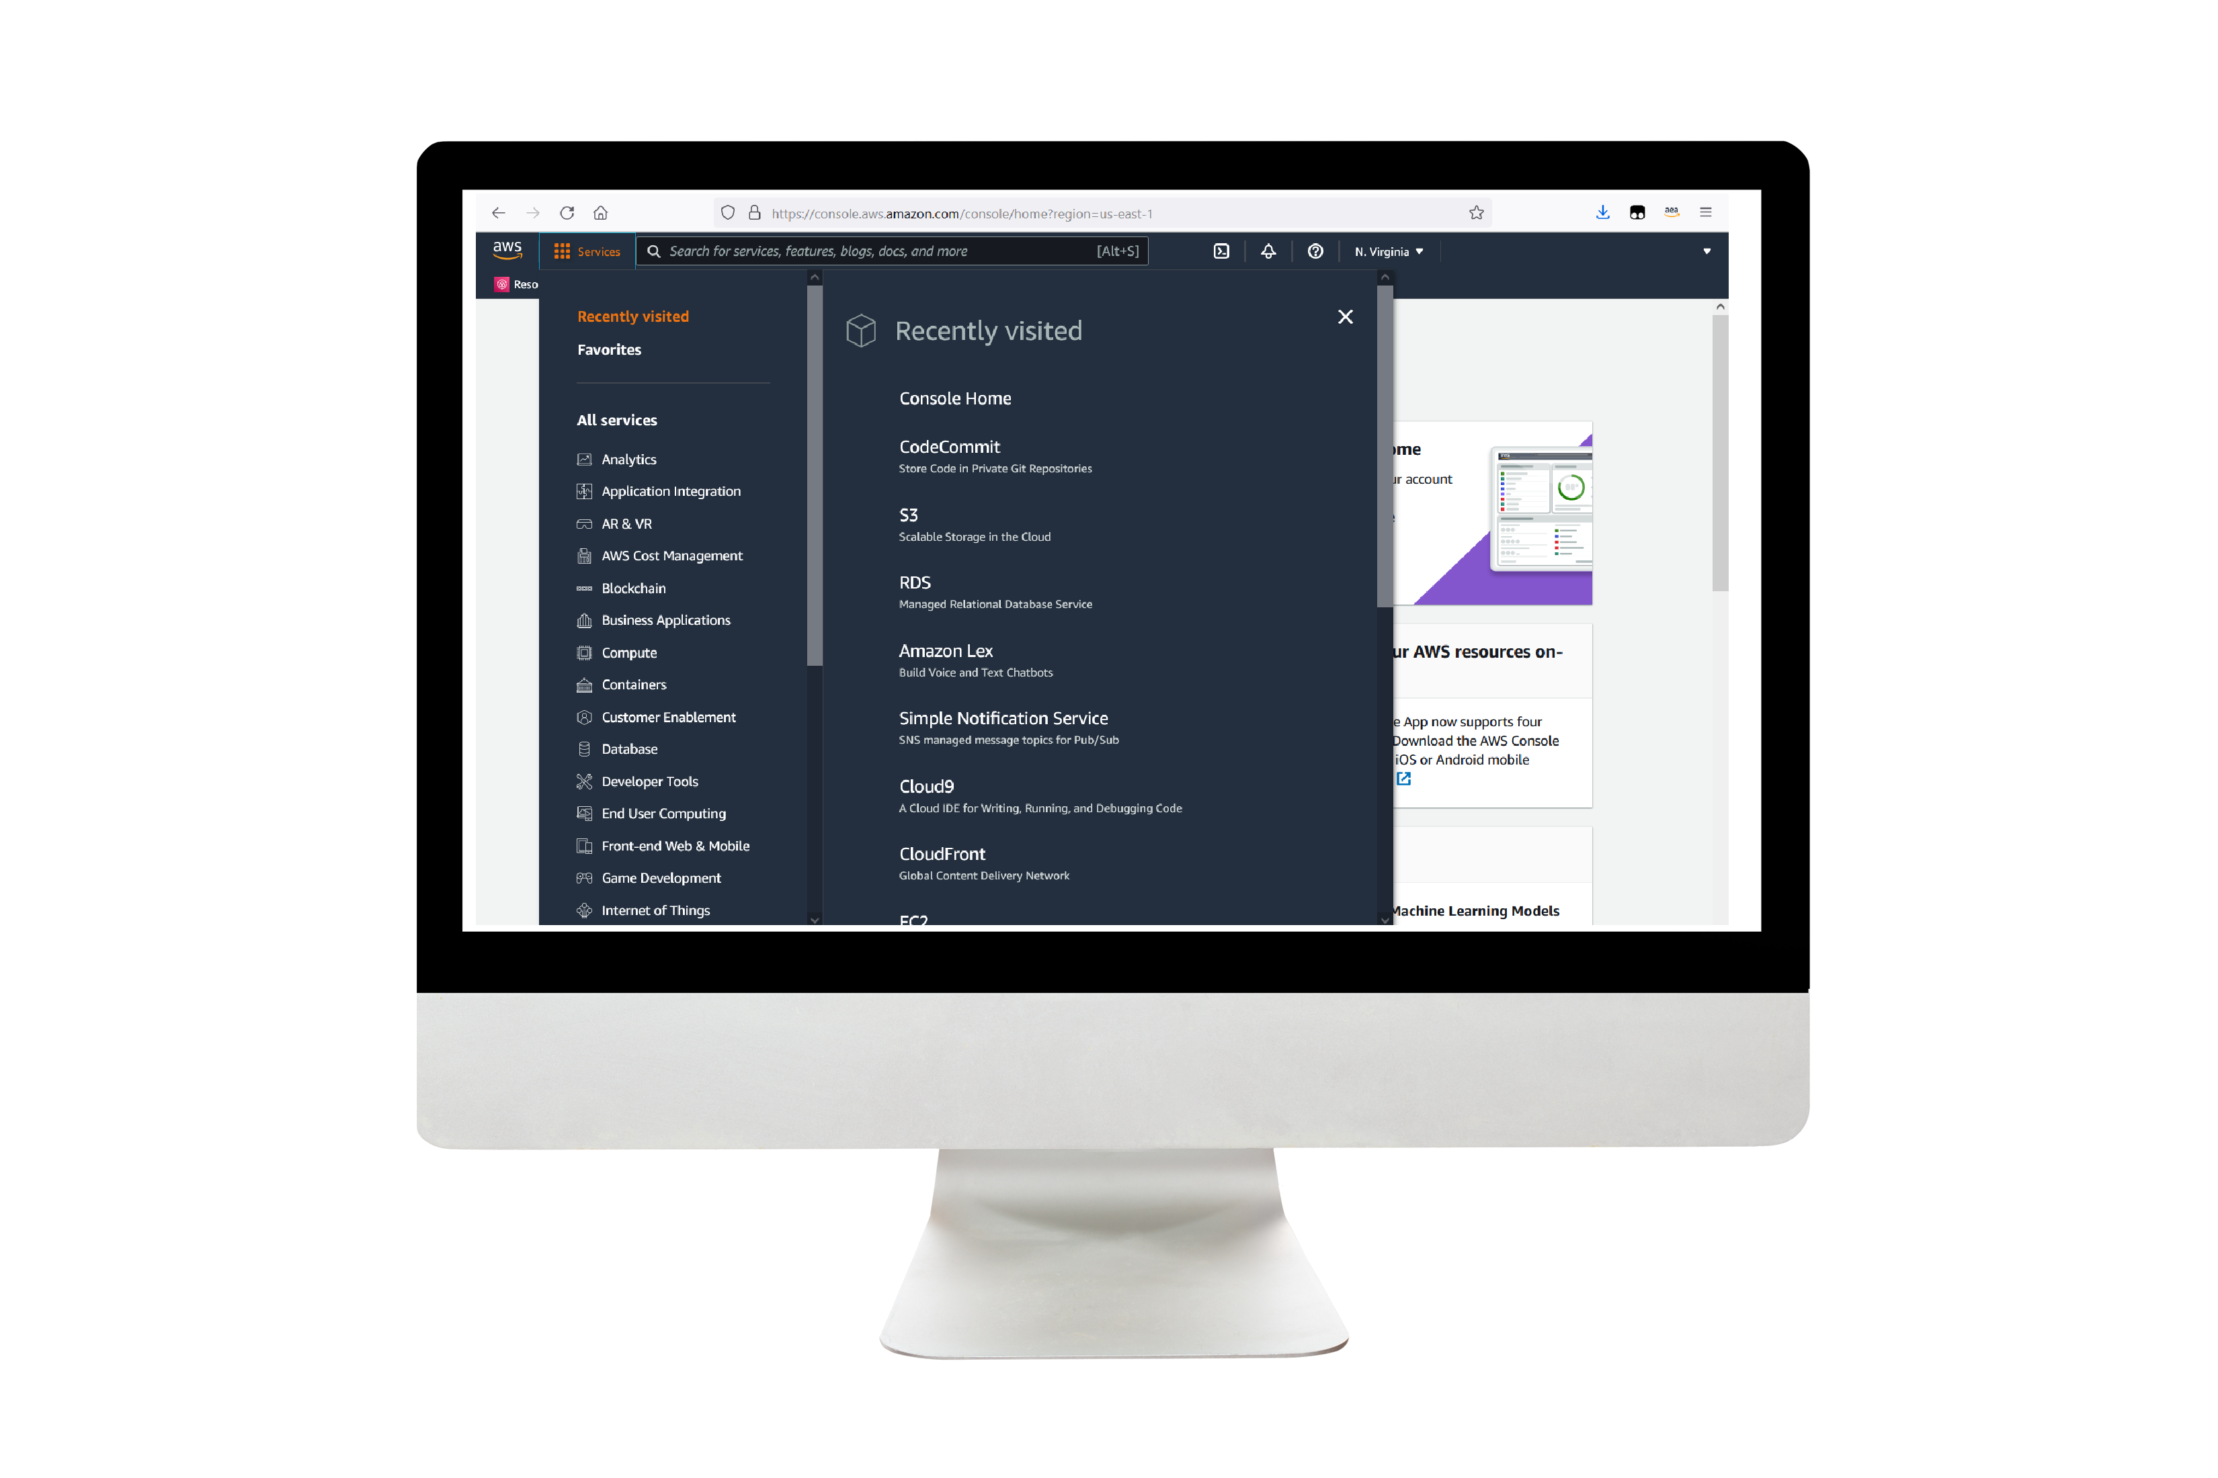
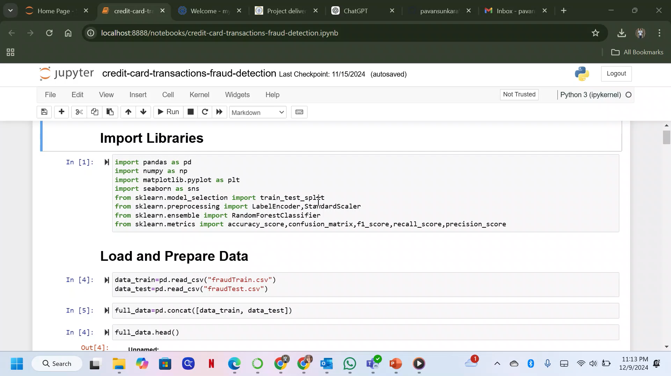
Work Location
Github: https://https://github.com/pavansunkara958/Fraud-Transaction-Detection-System
DEMO VIDEO
Notes:
For the demo, guide the audience through the two to three most important benefits of the solution and how it addresses the requirements.
Your demo materials can be screen captures, recordings, a link to your final solution, and/or a link to AWS console.

Slide 13
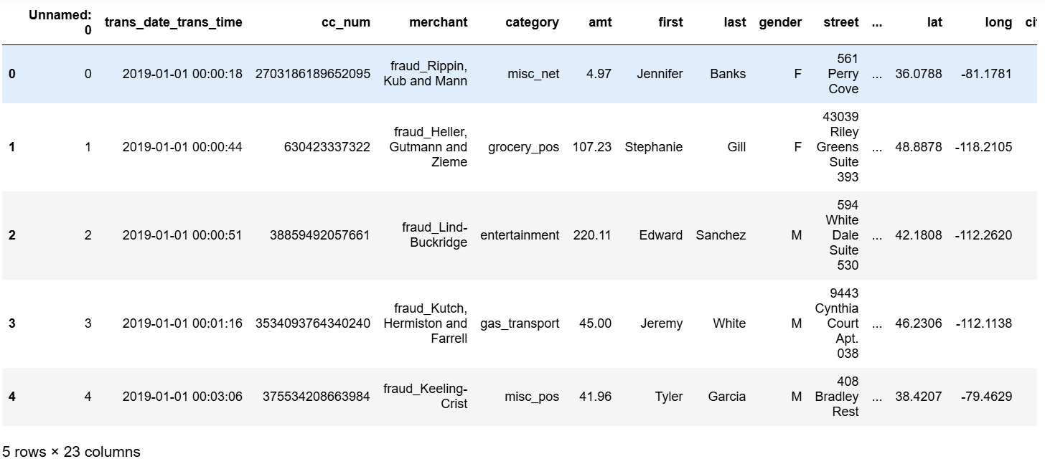
Concatination of trained data and test data

Slide 14
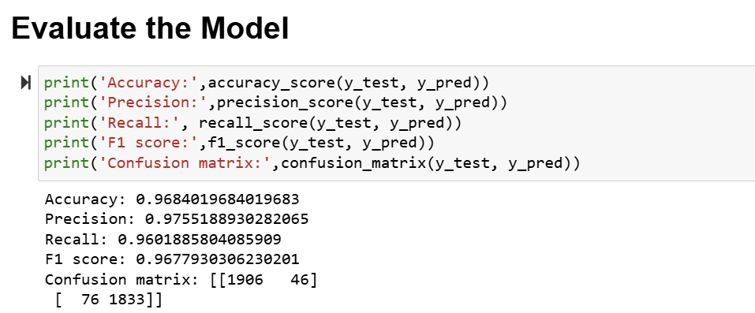
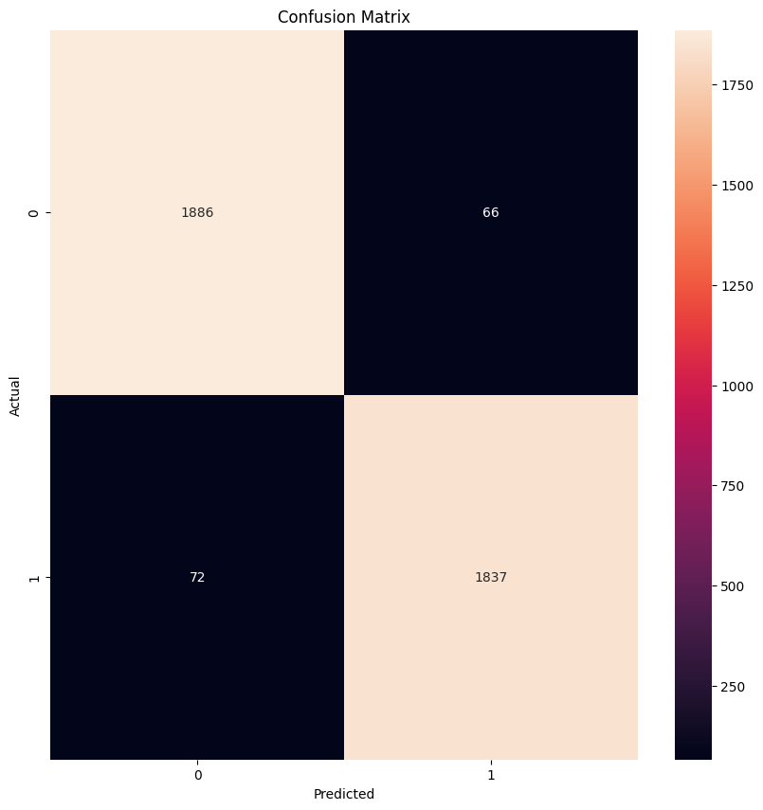
Evaluation of Model

Slide 15
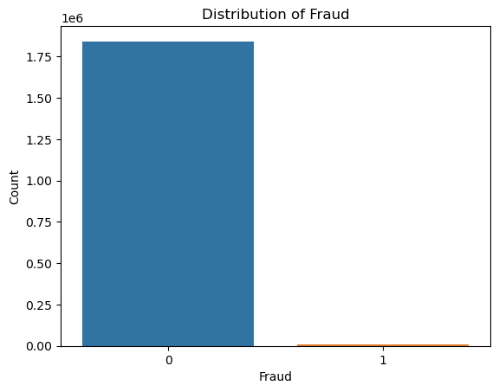
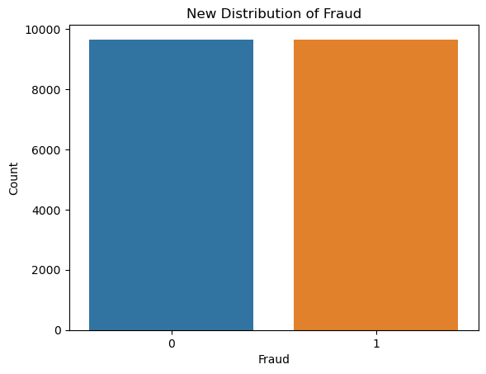
Distribution of fraud before and after data Processing
0’s- fraudulent transaction
1’s- Non-fraudulent transaction

Slide 16
Conclusion
Summary:
Successfully developed a robust pipeline for detecting fraudulent transactions.
Insights contribute to building safer financial systems.
Future Work:
Real-time fraud detection integration.
Deployment on live financial datasets.

Slide 17

THANK YOU!

